Slide 2
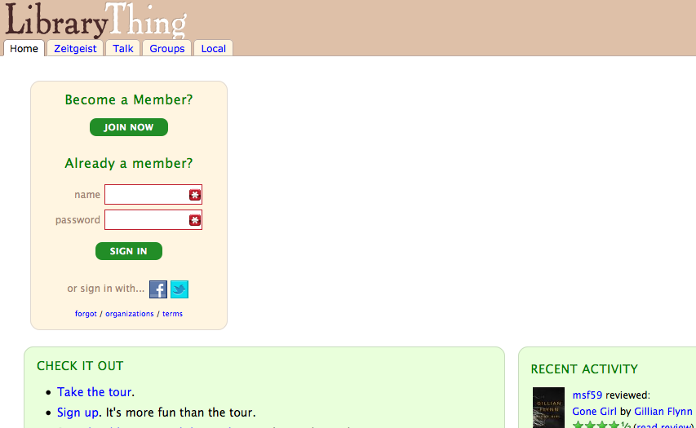
1. go to: www.librarything.com 2. log in

Slide 3
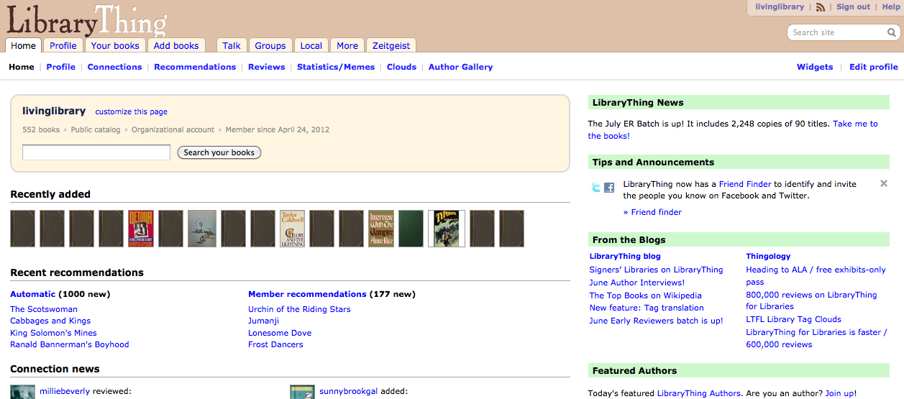
open the “Add Books” tab

Slide 4
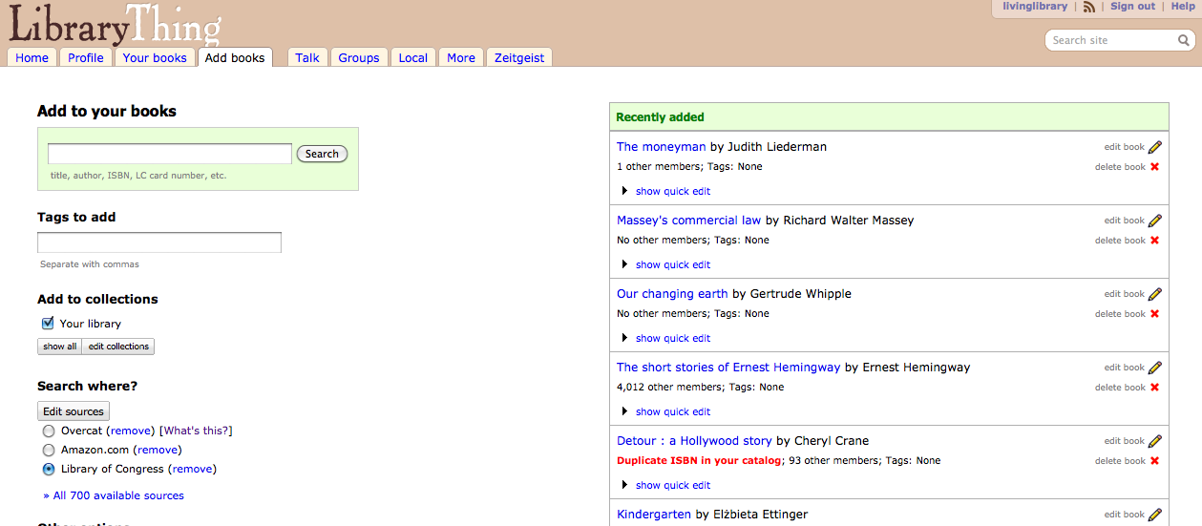
Find your book on the shelf!Then find its digital record!
type in the book’s title and/or author for best results (ISBNs are a little less reliable)
…but before you click “search”…
make sure you’re searching the Library of Congress catalog

Slide 5
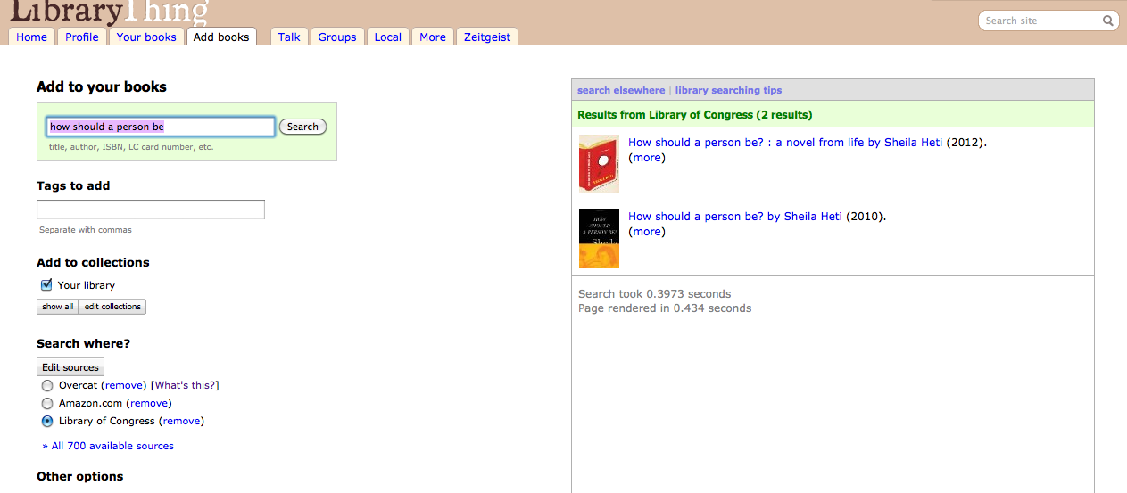
Once you've searched, potential matches will show up on the right side of the screen
click the title that matches the item in your hand, and you’re adding it to the collection!

Slide 6
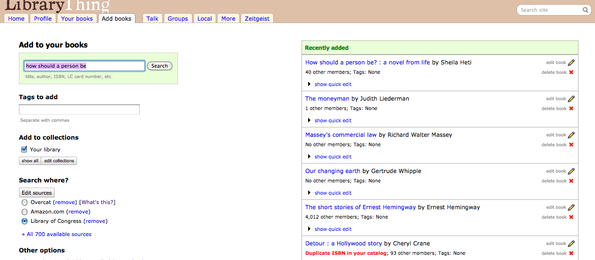
Once you've added it to the collection, click

Slide 7
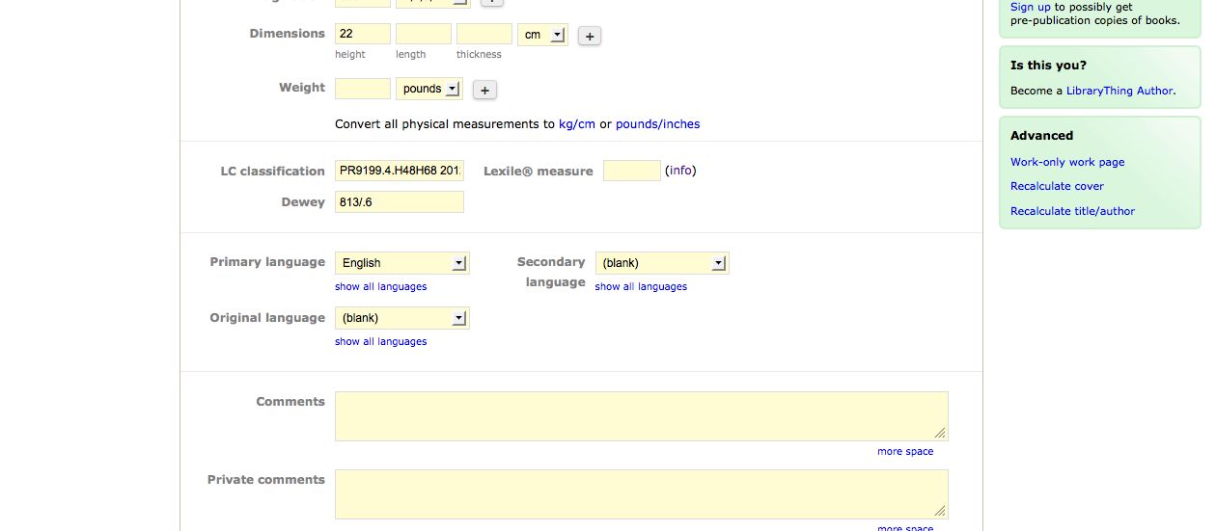
Scroll down to find “LC classification”
then write that number/letter combination down on the top part of a slip of paper, so that the classification is visible when the slip is sticking out of the book

Slide 8
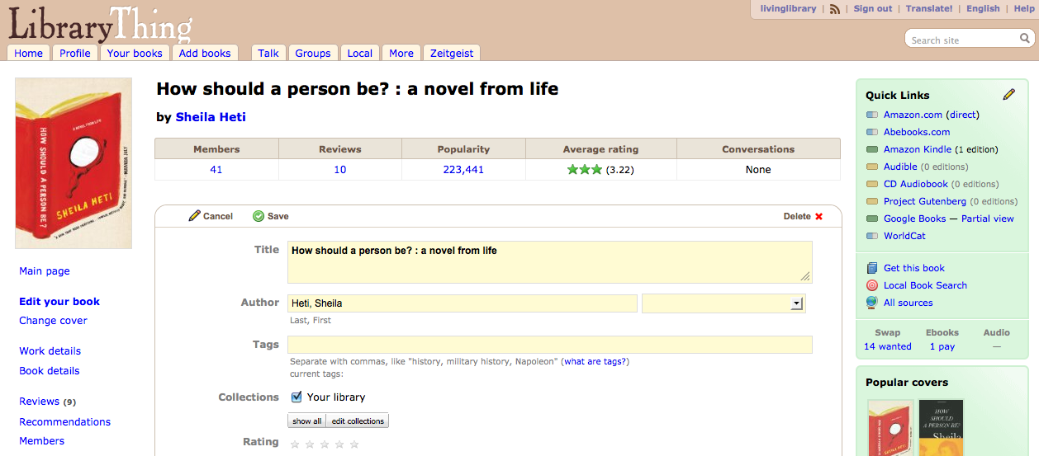
Scroll back up, then click “save”!
Put your slip in the book, and set it aside. You've finished cataloging your first book. You're practically a librarian now. Go shush someone!

Slide 9
My book doesn't have a digital cover/the digital cover doesn't match the physical cover. What do I do?
Click “change cover” (on the left side of the page). See if your cover appears as an option. If so, click on it and save! If not…
Search Google images to try to find the cover that you see on the physical item. If you find it, great! Save that picture to your desktop so it’s easy to find.
If not, take a picture with a digital camera, iPhone, iPod touch, or your computer.
Upload your cover photo.
Click save!

Slide 10
Some of the information on the digital record is different from my book’s information. (For example, my book says it was published by Penguin, but the digital record says Doubleday.) What do I do?
Change it! You can change the information in any field on the “edit book” screen. Just remember to check your accuracy and save your changes.
Don’t forget: your primary source of information is the book’s title page. If the title is different on the cover than the title page, use the title page version. Publisher/date/etc. are often found on the title page verso (the other side of the page)

Slide 11
My book doesn't have an LC classification number. What do I do?
Go to www.worldcat.org (in separate browser tab), and search for your book
You will see a list of other libraries that hold that item. Try to find a university (not a public library) that holds the title, then click the link to see it in the university’s catalog. Copy and paste the university’s classification number into the “LC classification” field, and write that number on a slip of paper and slide into the book.
Notes:
Why not a public library? Because generally, public libraries use the Dewey Decimal System, which is no good to us. We’re using the Library of Congress Classification System – a totally different thing!

Slide 12
My book isn't showing up anywhere in librarything. What do I do?
Write “no record” on a slip, put it in the book, and set it on a separate shelf. Better luck next time!

Slide 13
Questions?
Ask:
April Parker
a_parke2@uncg.edu
862-588-1521

